Slide 1
Business Architecture Capability Overview

Slide 2
Business Architecture Capability Reference Model
A reference model that defines the core, strategic and support business capabilities that are common to all State Medicaid Agencies (SMA’s).
Used in the ORBIT model to identify business architecture needs for a capability.
The model provides a set of business capabilities that are used for classifying an SMA's specific business needs to plan for and identify solutions, leverage, reuse and standardization opportunities.
Reference Model will have (2) levels including:
Capability Domain – High-level capability used to group common capabilities.
Capability Area – Detailed capabilities that decomposes the capability domain into sub-capabilities that can be used by SMA’s to classify their data management needs.

Slide 3
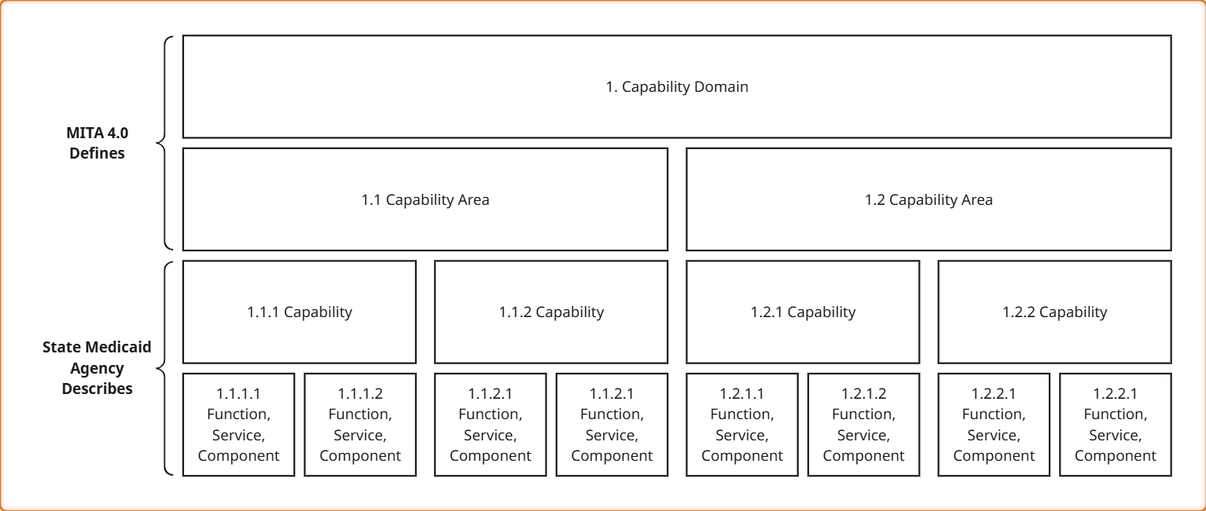
Capability Metamodel

Slide 4
MITA Capability Model
Core
Care and Service Coordination
Claims and Encounter Management
Contract Management
Financial Management
Member Management
Pharmacy Management
Provider Management
Strategic
Enterprise Architecture
Plan and Policy Management
Strategy and Planning Management
Support
Communication Management
Compliance Management
Data Management
Technology Management

Slide 5
Core Capabilities
Core
Care and Service Coordination
Claims and Encounter Management
Contract Management
Long-Term Care Support Management
Visit Verification Monitoring
Case Management
Prior Authorization
Care Information Management
Claims and Encounter Submission Management
Claims Adjudication
Encounter Processing
Claims and Encounters Adjustments
Claims and Encounters Lifecycle Management
Claim and Encounter Information Management
Contract Lifecycle Management
Contractor Management
Contractor Support Management
Contract Information Management
Financial Management
Accounts Receivable Management
Accounts Payable Management
Fiscal/Budget Management
Fund Management
Third Party Liability
Financial Information Management
Member Management
Pharmacy Management
Provider Management
Member Eligibility
Member Enrollment
Member Support Management
Member Information Management
Pharmacy Benefit Administration
Drug Monitoring Oversight
Pharmacy Information Management
Provider Enrollment
Provider Eligibility
Provider Monitoring
Provider Support Management
Provider Information Management

Slide 6
Strategic and Support Capabilities
Strategic
Enterprise Architecture
Plan and Policy
Management
Strategy and Planning
Management
EA Planning
EA Analysis
EA Design
EA Assessment
EA Maintenance
Enterprise Governance
Health Plan Administration
Health Benefits Administration
Program Administration
Waiver Management
Plan Information Management
Strategic Plan Maintenance
Strategic Roadmap Management
Strategy Oversight & Accountability
Strategy Information Management
Support
Data Management
Technology Management
Communication
Management
Compliance Management
Data Governance
Data Storage, Operations, & Warehousing
Data Architecture, Modeling, & Design
Master Data Management
Reference Data Management
Reference Data Management
Document & Content Management
Data Integration & Interoperability
Data Quality Management
Data Security & Privacy
Metadata Management
Compute & Storage
Networking & Technical Recover
Identity, Access, & Consent
Security Protection & Monitoring
System Operations & Monitoring
Development, Testing, Release, & Security Compliance
API, Messaging, & Integration
Application Hosting and Platform Services
Business Rules & Workflows
Modular Architecture
User Interfaces & Session Management
Communication Development
Communication Intake
Communication Dissemination
Public Affairs
Communication Information Management
Program Monitoring Management
Program Performance Evaluation
Compliance Information Management

Slide 7
Provider Management
Provider Enrollment - The Provider Enrollment capability encompasses the business processes and functions required to register providers to participate in the Medicaid program and ensuring that only qualified, eligible, and compliant providers are allowed to provide services to Medicaid clients. This includes the intake of new applications, updates to existing provider records, and removal of providers from the network when needed. This ensures provider data is accurate, validated, and aligned with state and federal regulations, while supporting continuity of care for Medicaid clients.
Provider Screening - The Provider Screening capability ensures that all providers meet the eligibility, screening, and compliance requirements necessary to participate in the Medicaid program. This includes validating professional licenses, certifications, education, training, work history, and conducting required screenings such as federal and state exclusion lists, criminal background checks, and site visits to confirm legitimacy and compliance with Medicaid standards. This capability applies both during initial enrollment and on an ongoing basis to protect program integrity, reduce fraud, and safeguard Medicaid client access to qualified providers.
Provider Management - The Provider Management capability supports the continuous process of overseeing provider compliance and performance and maintaining current and accurate provider data to ensure that providers remain compliant and program risk is mitigated as needed. This includes periodic revalidation of provider eligibility, proactive monitoring of provider performance and risk indicators, and interventions when risk factors are identified. This helps to ensure states maintain a compliant, effective, and reliable Medicaid provider network.

Slide 8
MITA 4.0 – Business Capability Reference Model
Example
Capability Domain
Provider Management
Capability Area
Provider Enrollment

Slide 9
MITA 3.0
Technical Architecture
MITA 4.0
MITA 3.0
Business Architecture
Technical Service Area
Capability Domain
Business Area
Technical Service Classification
Capability Area
Business Category

Slide 10
Applying to ORBIT Model

Slide 11
Orbit Model
O
Outcome
R
Roles
B
Business Process
I
Information
T
Technology

Slide 12
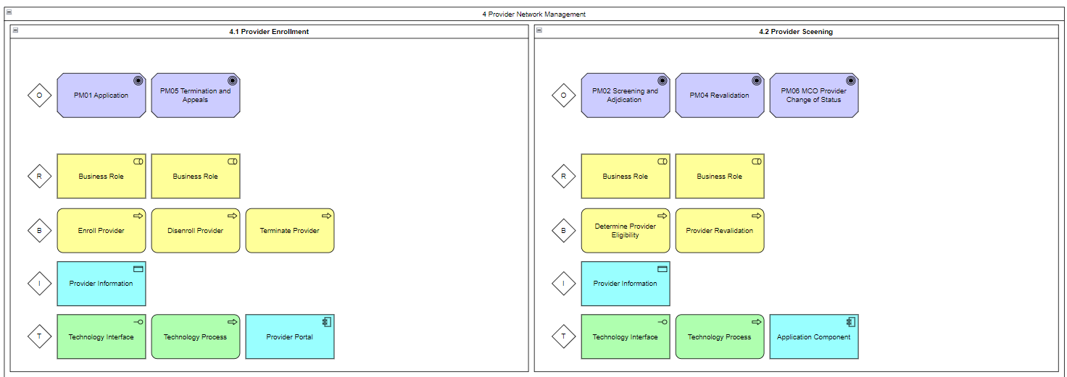
ORBIT Model Example

Slide 13
IA Component in ORBIT
Input: Roles & Business Processes
Output | Description | MITA 4.0 Reference
Information | Information needed to support capability | Data Reference Model
Data Management Capabilities | Data Management capabilities needed to support capability | Data Management Capability Reference Model
Information Architecture Views | Relationships to Business Processes that access the information Relationships to roles that provide/consume the information Relationships to technology that utilize the information | Information Architecture Viewpoints
Information Architecture Maturity Assessment | Maturity level of the data management capabilities that are needed to support the capability including As-Is and To-Be levels. | Information Architecture Maturity Criteria
Information Outcomes | Identification of desired outcomes and measures associated with the information. (e.g. Data Completeness)

Slide 14
Identifying Data Management Capability Needs
# | Step | Function | Data Management Capability
1 | START: Health Care Provider completes and submits an enrollment application or existing Provider submits enrollment application for revalidation. | Send Data | Data Integration & Interoperability
2 | Requestor identifies Office of the National Coordinator for Health Information Technology (ONC) Authorized Testing and Certification Body (ATCB) certification for electronic health record incentive. | Create Data | Data Storage, Operations & Warehousing
3 | Requestor identifies if they are currently participating in Medicare or Children’s Health Insurance Program (CHIP). If yes, skip to step 14. | Create Data | Data Storage, Operations & Warehousing
4 | Validate submitted enrollment application information | Validate data | Data Quality
5 | Requestor selects application fee payment option including designation of hardship or exclusions from payment. | Create Data | Data Storage, Operations & Warehousing
6 | Requestor provides appropriate payment information. | Create Data | Data Storage, Operations & Warehousing

